Slide 1
Participation of Nepal
in
7th GPDRR 2022, Bali, Indonesia
23-28th May
(41 days to go)
Presented by: DPNet
12th April, 2022

Slide 2
About GPDRR
7th Session of Global Platform will be convened and organized by the UN Office for Disaster Risk Reduction (UNDRR) and co-chaired and hosted by the Government of Indonesia in event will held in Bali, Indonesia.
GPDRR is the main global forum to assess and discuss progress on the implementation of the Sendai Framework for Disaster Risk Reduction.
The Global Platform comes at a critical time: seven years after the Sendai Framework was adopted, and just over two years after the COVID-19 pandemic broke out, which has exposed how underlying vulnerabilities and inequities have catastrophic consequences for the most exposed across the world. The pandemic has underlined the critical need of prevention and risk reduction in achieving a sustainable future for all.

Slide 3
Global Platform over the years (3 World Conference, 6 Global Platform)

Slide 4
GPDRR 2022 THEMES
The Global Platform sessions are organized around three main sub-themes and three cross-cutting themes, which inform the content of the programme.
Main Themes
Disaster Risk Governance
COVID-19 Recovery
DRR Financing
Cross Cutting Themes
1. Sendai Framework Stocktaking
2. Leave no one behind
3. SDGs and climate action

Slide 5
GPDRR 2022 THEMES
From Risk to Resilience: Towards Sustainable Development for All in a COVID-19 Transformed World.
The theme will focus on how the COVID-19 pandemic has challenged the traditional understanding of risk and disaster risk governance. It will explore how the global crisis can be turned into an opportunity for the necessary radical transformation needed to achieve the goal and targets of the Sendai Framework, as well as of the 2030 Agenda.

Slide 6
Pathway to developing the GP2022 Theme
Global risk updates and emerging new risk (COVID Pandemic).
Outcomes of previous Global and Regional Platforms.
Global policy context and links to other international frameworks, in particular the themes of the High-Level Political Forum on Sustainable Development.
Specific Sustainable Development Goals (SDGs) that will be reviewed.
Input received from governments and other stakeholders

Slide 7
GPDRR 2022 - Main Events
Opening and Closing sessions
Session(s) on Disaster Risk Reduction to tackle the Climate Emergency, Understanding and Governance of Systemic Risk, DRR Leadership and resilient.
Sharing Global and regional perspectives on implementing the Sendai Framework and Early Warning and Early Action
Nature Based solutions, multi-hazard - multi-sectoral approaches, disaster risk financing, COVID-19 and about resilient
Joint Actions to reduce DRR, empowering, strengthening and embedding risk in investment decisions
Sharing of Official Statements

Slide 8
Other Events
“The Sasakawa Award” - will honor practices and efforts made by institutions, individuals and groups that have best contributed to building resilience through a multi-hazard approach.

Slide 9
Outcomes
The Global Platform 2022's outcome will provide a unique and timely opportunity to highlight the need of international solidarity and cooperation, as well as propose solutions to address underlying risk factors both locally and globally.

Slide 10
Focus
Focus of Each Day
Day 1: strengthening and managing diversities in DRR and Climate risk, understanding and governance of risk, early warning and action and sharing official statements .
Day 2: Disaster Risk Financing, Nature based solutions, learning from COVID -19, data challenges, strengthening governance, inclusive and resilient recovery in urban context.
Day 3: Action on climate and disaster risk, Empowering the most at risk through social protection, Embedding Risk in Investment Decisions, Enhancing Understanding and Management of Disaster Risk in Humanitarian Contexts and Accelerating Financing for Risk Prevention

Slide 11
Program at a Glance
Official Programme
High-Level Dialogues
Ministerial Roundtables
Thematic Sessions
Official statements
Mid-term Review Plenaries
Informal Programme
Side Events
Innovation Platform
Ignite Stage
Learning Labs
Field Visits

Slide 12
Prospective Events for Team Nepal
Ministerial Round Tables
Scaling-up Disaster Risk Reduction to Tackle the Climate Emergency
Thinking Resilience: Changing the Approach to Disaster Risk Reduction

Slide 13
Prospective Events for Team Nepal
High-Level Dialogues
The four High-Level Dialogues present an opportunity for representatives from governments, international organizations and other stakeholder groups to share experiences and discuss strategies for accelerating the implementation of the Sendai Framework.

Slide 14
Prospective Events for Team Nepal
22 Different Working Sessions on different issues
90 Minutes sessions
Comprises of a moderator and 4-5 panelists
Participation (Open to all Participates) including participants from virtual mode

Slide 15
Prospective Events for Nepal Team
Official Statements
Governmental official statement
Non-governmental official statement
GP2022 Official Statements are submitted via the GP2022 website official statement form. Written statements can be submitted to UNDRR between 1 March and 28 May 2022.
Delegations are encouraged to submit their statements as soon as possible. Statements submitted at the latest by 1 May 2022 will be available on the website by 23 May 2022. Statements submitted after this may only be available on the GP2022 website after 29 May.

Slide 16
Major Events to Participate by Govt. Delegation
Official Statements (9:00 to 19:00 of May 25)
Ministerial Round Table (Scaling-up Disaster Risk Reduction to Tackle the Climate Emergency) 15:00 to 17:30 of May 25
Ministerial Round Table (Thinking Resilience: Changing the Approach to Disaster Risk Reduction Financing) 10:30 - 13:00 of May 26
Bilateral Meeting (Date and time depend on our communication)

Slide 17
Proposed additional plan (Nepal Team)
Book a private hall in the hotel at nearby.
Use the hall as common place to meet, discuss and share the information and to coordinate all the activities
Present the important paper including position paper among various stakeholders in daily basis
Utilize the hall as a showcase of Nepalese stakeholders' achievement in the field of DRR
Publish the presented paper in Prevention Web
Use Viber, Whatsapp platform to coordinate Nepal Team

Slide 18
Proposed content of Position Paper (option 1)
Introduction
Disaster fact sheet
International commitments and instruments
National instruments
Major achievements
Status of implementation of SFDRR
Commitments for next two years
Conclusion

Slide 19
Proposed content of Position Paper (option 2)
Boarder theme of GPDRR Event
Day 1: Strengthening and managing diversities in DRR and Climate risk, understanding and governance of risk, early warning and action and sharing official statements .
Day 2: Disaster Risk Financing, Nature based solutions, learning from COVID -19, data challenges, strengthening governance, inclusive and resilient recovery in urban context.
Day 3: Action on climate and disaster risk, Empowering the most at risk through social protection, Embedding Risk in Investment Decisions, Enhancing Understanding and Management of Disaster Risk in Humanitarian Contexts and Accelerating Financing for Risk Prevention

Slide 20
Proposed content could be align with GPDRR program schedule
1. Progress made since the last Global Platform
Progress made in implementing Sendai framework
National and Local DRR Strategies
Sendai Framework Implementation

Slide 21
Proposed content could be align with GPDRR program schedule
2. Risk Informed Public and Private Investment
Risk informed investments
Build Back Better
Leaving no-one behind (investing in local action and empowering those most at risk)
DRR investment
Health issues in DRRM policies
Promoting locally led DRRM

Slide 22
Proposed content could be align with GPDRR program schedule
3. Climate change action and DRR for all
National DRR Strategies and Climate National Adaptation Plan
Role of infrastructure in reducing disaster risk
Integrating risk management ecosystem and water related risks
Multi-hazard early warning system
Achieving climate and disaster resilience
4. Way forward and Conclusion

Slide 23
Proposed content of Position Paper (option 3)
Background (Including disaster scenario of Nepal)
Understanding disaster risk (Risk Perception, Risk Assessment, DIMS, capacity building)
Strengthening disaster risk governance (Strategic action plan for DRR, principles, vision, goal, target, Existing legal and policy framework, Institutional structure, collaboration and partnership, inclusiveness e.g. LNOB, gender & didrr, social security)
Public Private investments in DRR (Promotion of public and private investment in DRR, Risk Transfer)
Emerging Disaster like COVID pandemic
Enhancing preparedness ad promote build back better (Promote Preparedness, MH Early warning system, CBDRR, CBPR, Capacity building in search and rescue, Build Back Better)
Implementation status of Sendai framework
Challenges (less investment in preparedness, Coherence in different national and international instruments, prevalence of new forms disaster, urbanization, unprecedented disaster)
Way Forward (International support for technological transfer, knowledge management

Slide 24
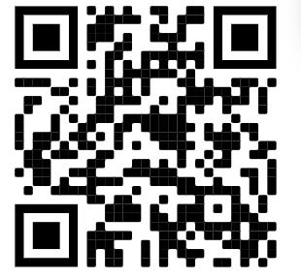
Official Statement
Issues to be accommodated
The statements are expected to focus on:
Major achievements and challenges in implementing the Sendai Framework (emphasis on the last two years);
Progress in achieving the Target e and f;
Commitments to further accelerate implementation of risk-informed sustainable development
?
?
Please visit
https://dpnet.org.np/resource/position-paper
for previous position paper

Slide 25
Proposed DPNet Role in GPDRR
Coordination as per NPDRR decision and direction
Pre-departure meeting in coordination with NPDRR
Information collection and sharing among prospective participants
Coordination to prepare position paper, official statement and agenda to be discussed in bilateral meeting
Logistic including hall arrangement, program mgmt. in Bali
Support delegation for bilateral meeting
GPDRR participation review meeting and preparation of GPDRR participation report

Slide 26
Visa Application and Travel Related Info
online visa form should be filled up
https://kemlu.go.id/portal/en/kedutaan
Printed copy of application form along with documents listed in the following link should be submitted
https://kemlu.go.id/portal/en/page/29/kedutaan_konsulat
Contact for Visa:
Mr. Chandra Prasad Dhakal
Address : A.K. Khan & Company Limited. Batali Hills, Chittagong (GPO Box 223), Bangladesh
Phone : (88-31) 613-953, 611-050, 611-052

Slide 27
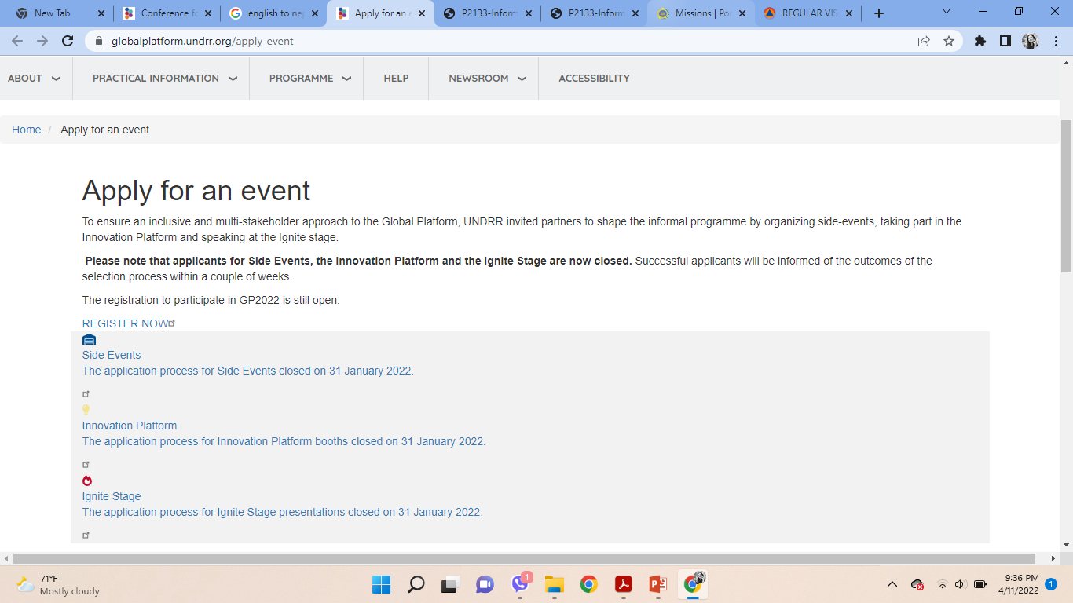
Visa Application and Travel Related Info
Only Official Statement Left (Nepal Team should come up with single official statement)

Slide 28
Visa Application and Travel Related infor
As more than 5000 people are visiting alone for the GPDRR event from 13 to 17 there slim chance to get economy ticket in last hour

Slide 29
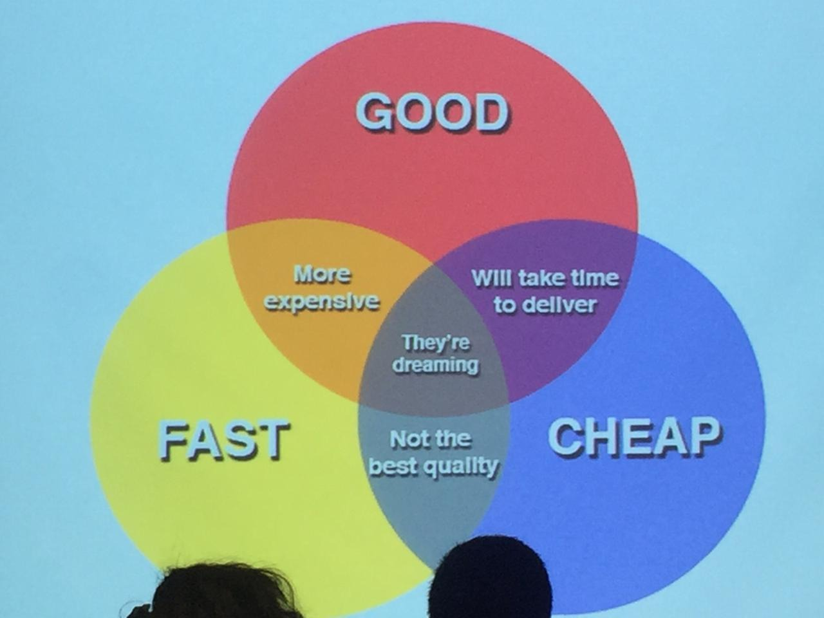
Resource for GPDRR Nepal Delegation
No commitment till data
41 days to go
Most of the activities based on financial resources
We should keep in mind interrelation of good, fast and cheap

Slide 30
Thank You!

